Slide 1
Simulation & Development of the RTPC for the BONuS12 Experiment in CLAS12
Nathan M. Dzbenski
Dissertation defense - 07 May 2019

Slide 2
BONuS12 MOTIVATION Nucleon Structure
Protons and neutrons (nucleons) both contain 3 valence quarks
u
d
d
u
u
d
Proton
Neutron
These nucleons also contain quark-antiquark pairs in a constant state of creation and annihilation. These are called “sea quarks”.
The valence quarks all have momentum within the confines of the nucleon. The fraction of the total momentum carried by a single quark is called the Bjorken-x (or just x).
2/38

Slide 3
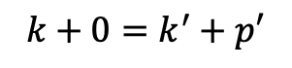
BONuS12 MOTIVATION Electron scattering experiments
One of the purposes of scattering experiments is to probe a target in order to determine its structure.
k’
k
e-
target
p=0
p’
momentum before = momentum after
$$k+0=k^{′}+p′$$
By detecting particles in the final state and using conservation laws we can study the probability of a particular reaction, which leads to increased understanding of the underlying nuclear physics.
3/38

Slide 4
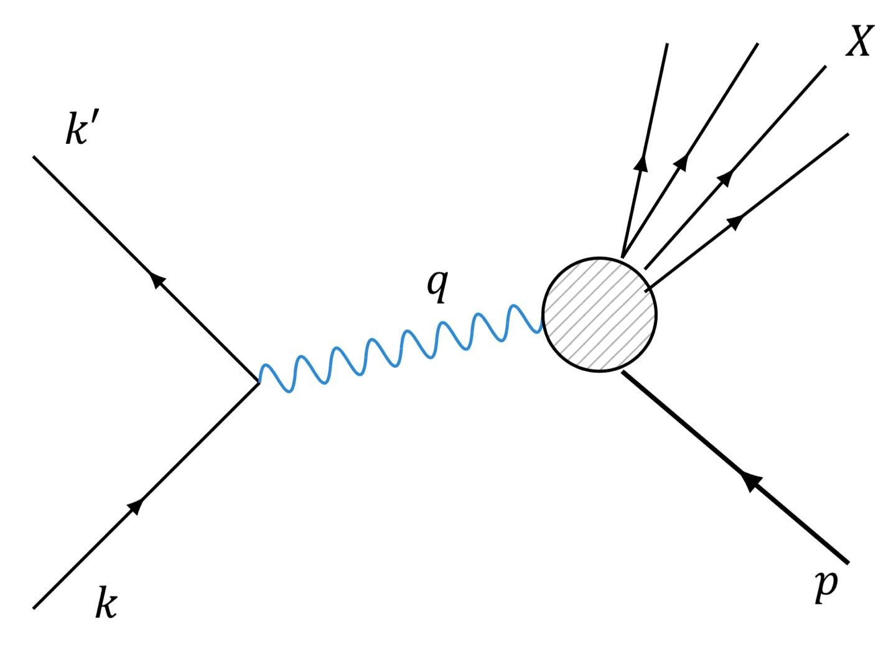
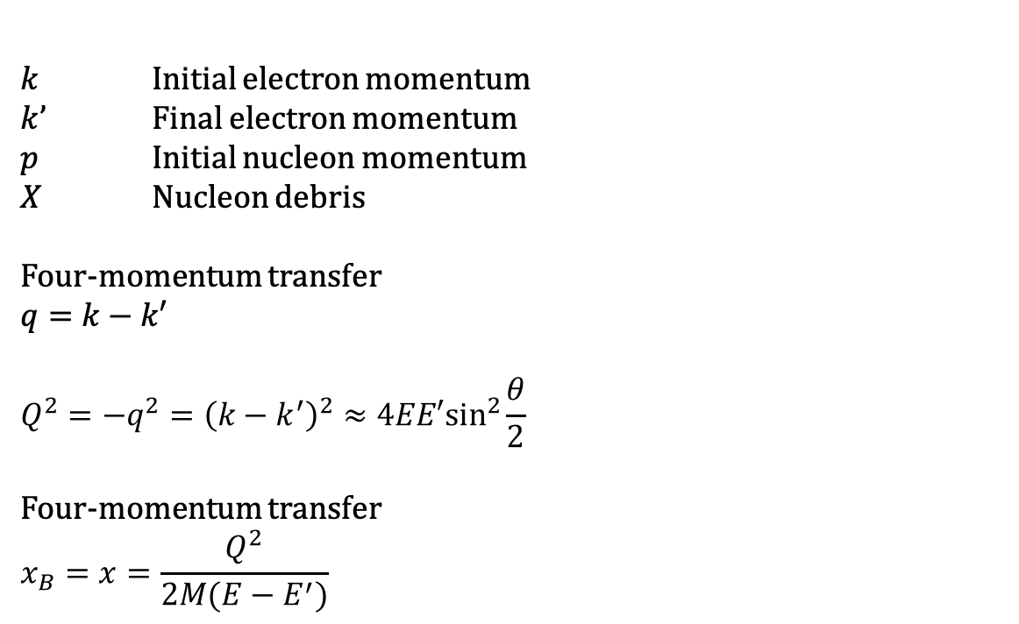
BONuS12 MOTIVATION Deep Inelastic Scattering Kinematics
Deep inelastic scattering is when scattering occurs off a constituent particle within a nucleon, breaking the nucleon into other particles.
$k$ Initial electron momentum
$k$’ Final electron momentum
$p$ Initial nucleon momentum
$X$ Nucleon debris
Four-momentum transfer
$$q=k−k′$$
$$Q^{2}=−q^{2}={\left(k−k^{′}\right)}^{2}≈4EE′\sin^{2}\frac{θ}{2}$$
Four-momentum transfer
$$x_{B}=x=\frac{Q^{2}}{2M(E−E^{′})}$$
4/38

Slide 5
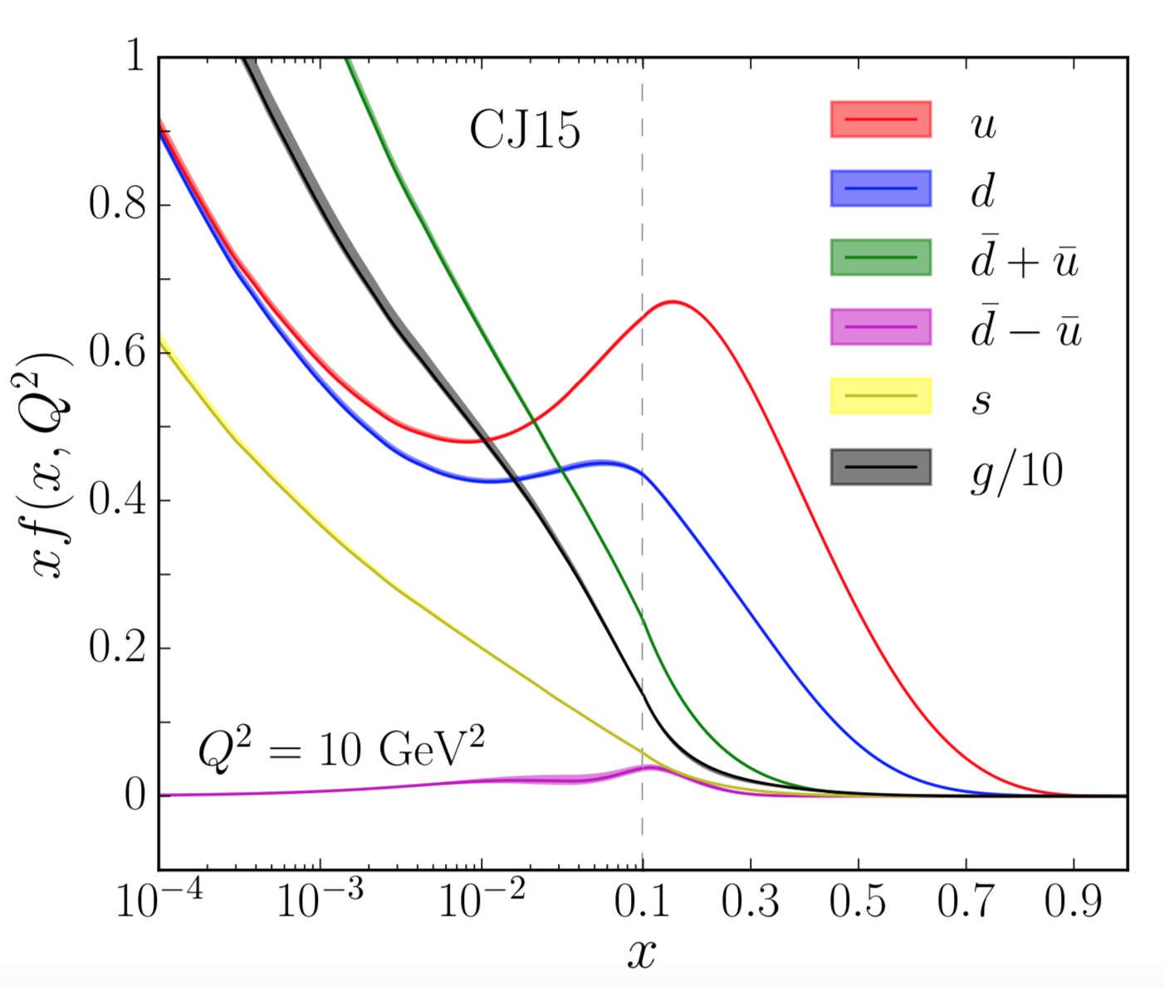

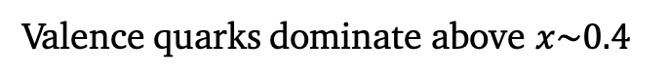
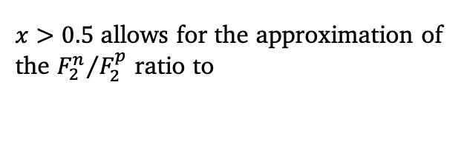
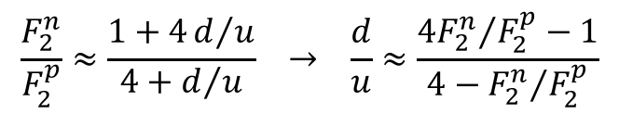
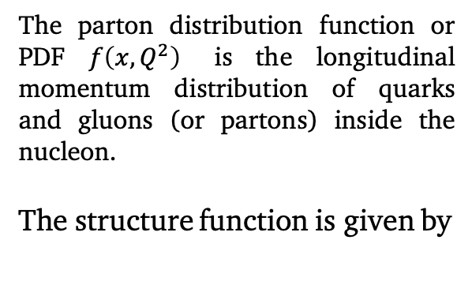
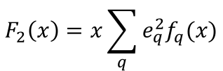
BONuS12 MOTIVATION Nucleon Structure Function at Large $x$
Valence quarks dominate above $x\sim 0.4$
The parton distribution function or PDF $f\left(x,Q^{2}\right)$ is the longitudinal momentum distribution of quarks and gluons (or partons) inside the nucleon.
The structure function is given by
$$F_{2}\left(x\right)=x\sum_{q}{e_{q}^{2}f_{q}(x)}$$
$x>0.5$ allows for the approximation of the ${F_{2}^{n}}/{F_{2}^{p}}$ ratio to
$$\frac{F_{2}^{n}}{F_{2}^{p}}≈\frac{1+4d/u}{4+d/u} → \frac{d}{u}≈\frac{{4F_{2}^{n}}/{F_{2}^{p}−1}}{4−{F_{2}^{n}}/{F_{2}^{p}}}$$
S. Tkachenki, et al. Phys. Rev. D, 93, (2016).
5/38

Slide 6
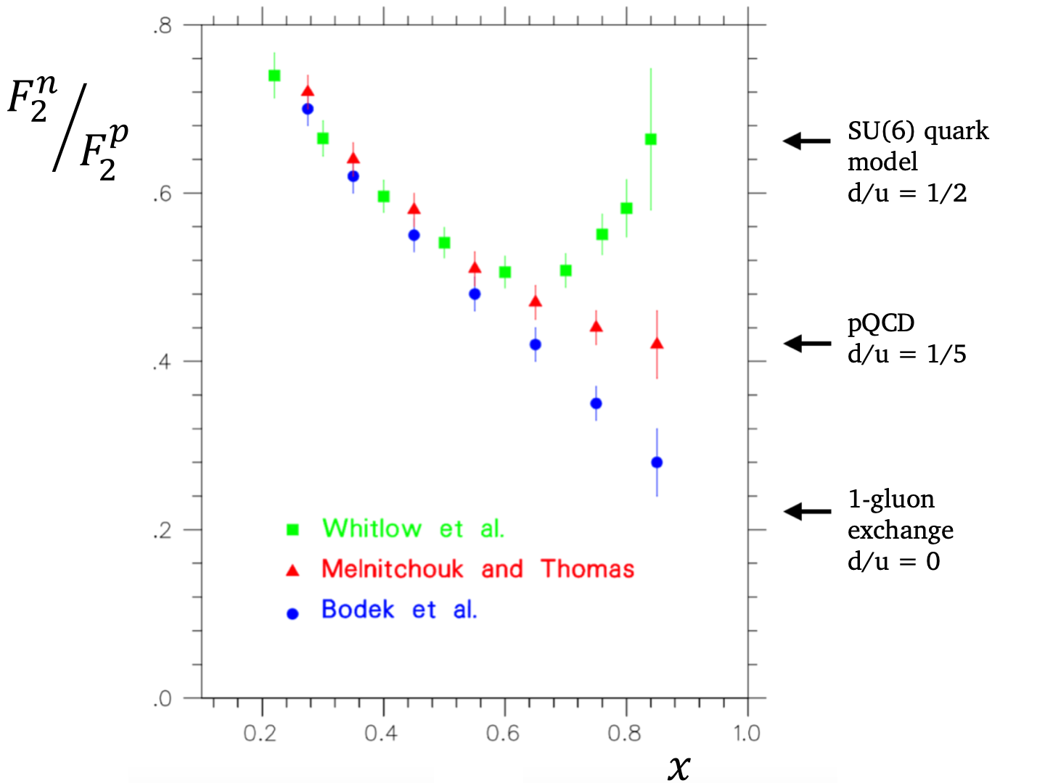

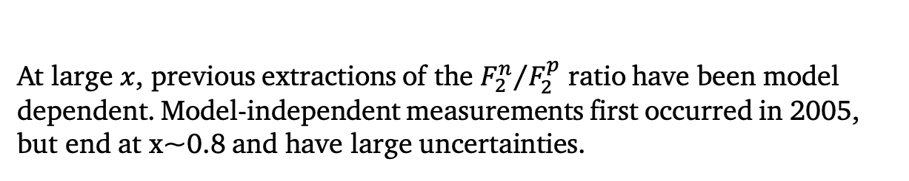
BONuS12 MOTIVATION Nucleon Structure Function at Large $x$
S. Tkachenki, et al. Phys. Rev. C 89, 045206 (2014).
At large $x$, previous extractions of the ${F_{2}^{n}}/{F_{2}^{p}}$ ratio have been model dependent. Model-independent measurements first occurred in 2005, but end at x~0.8 and have large uncertainties.
6/38

Slide 7
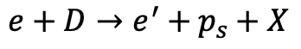
BONuS12 MOTIVATION Spectator Proton Tagging
The purpose of spectator tagging is to select events that involve the scattering of the electron off of the neutron in deuterium.
e’
X
D
𝛾*
n
p
e
p_{s}
$$e+D→e^{′}+p_{s}+X$$
By detecting low-momentum, backward-going protons that result from the scattering, we minimize significant final state interactions between the debris from the neutron and the spectator proton.
7/38

Slide 8
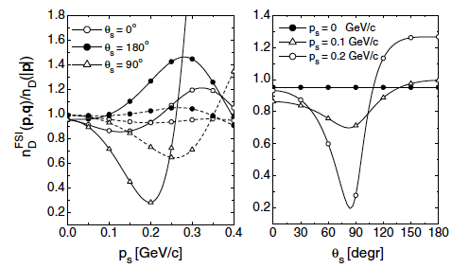
BONuS12 MOTIVATION Reducing Final State Interactions
FSI are minimized for $p_{s}<100$ MeV/c and $θ_{pq}>100°$
C. degli Atti et al, Eur. Phys. J. A 19,145 (2004).
8/38

Slide 9
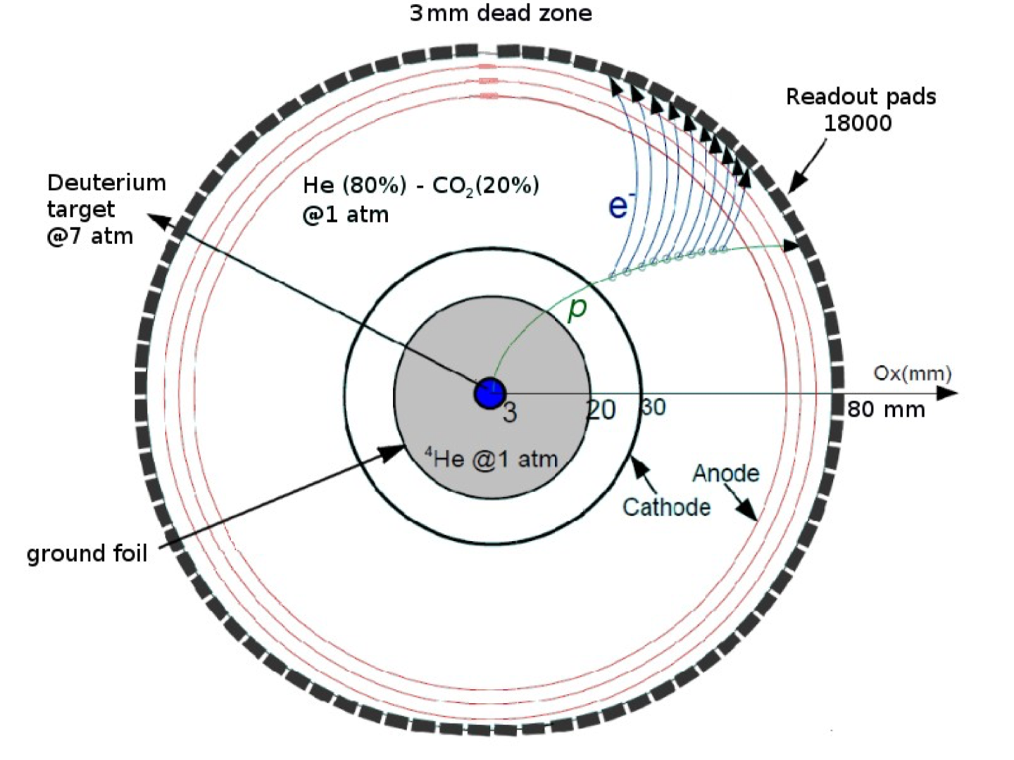
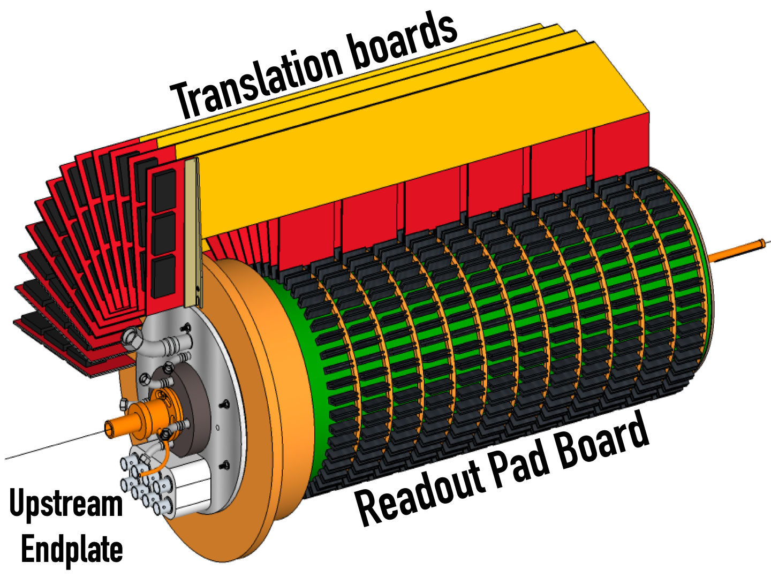
Radial Time Projection Chamber
17280
9/38

Slide 10
CEBAF Large Acceptance Spectrometer CLAS12 Detectors
EC
FTOF
DC
LTCC
Solenoid
RTPC
HTCC
Torus
The BONuS12 RTPC will be installed in the CLAS12 in Hall B.
10/38

Slide 11
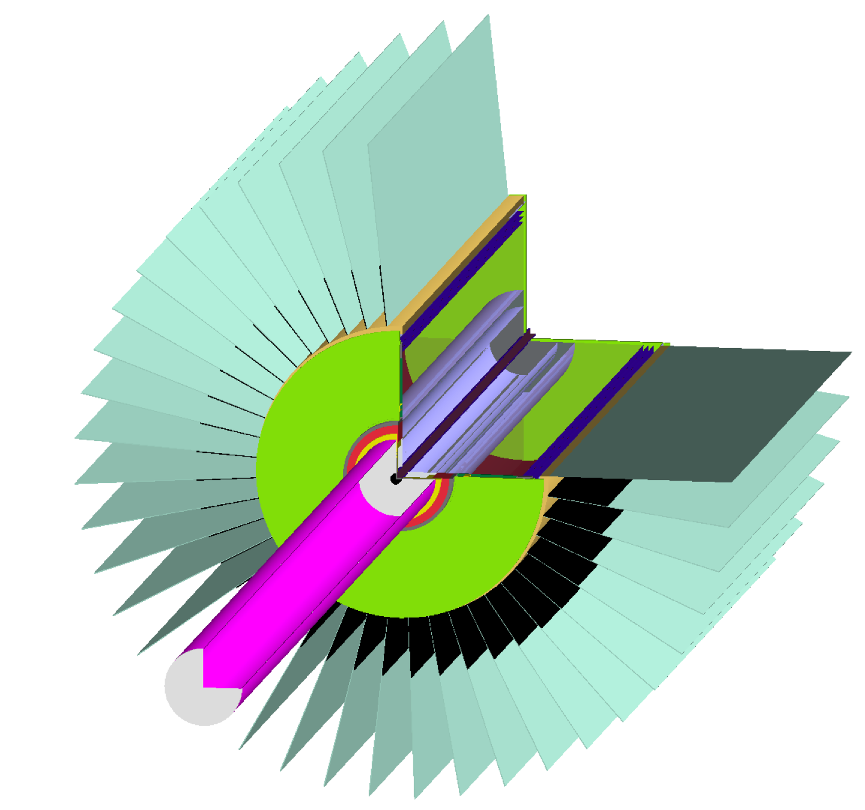
Simulation GEant4 Monte Carlo (GEMC)
Combined volume of
supports, electronics
and air
Translation boards
Downstream end plate
Protection circuits
Helium snout
GEMC is a Monte-Carlo based package of Geant4 used primarily for CLAS12.
Geant4 is a toolkit used to simulate particles passing through and interacting with matter.
11/38

Slide 12
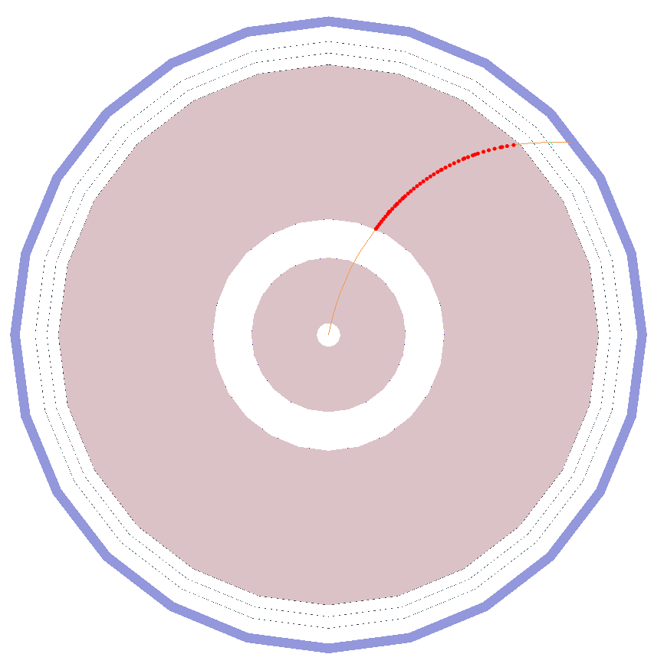
Simulation Plots SOURCE: GEMC
Ionization points
Proton track
5T magnetic field along z-axis
12/38

Slide 13
Simulation Plots SOURCE: GEMC
Ionization points
Proton track
13/38

Slide 14
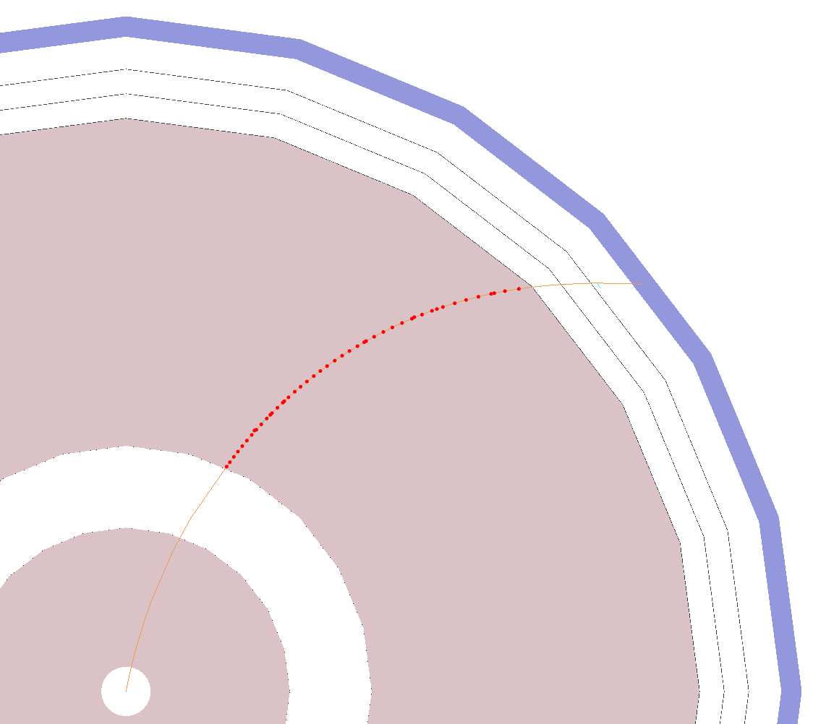
Simulation Plots SOURCE: GEMC
Ionization points
Proton track
Electron drift
14/38

Slide 15
Simulation Plots SOURCE: GEMC
Ionization points
Proton track
Electron drift
15/38

Slide 16
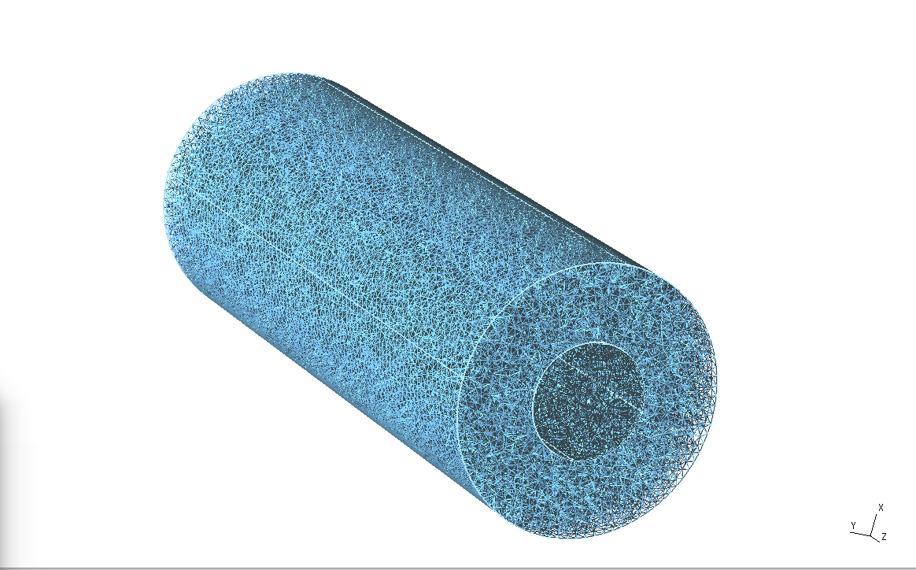
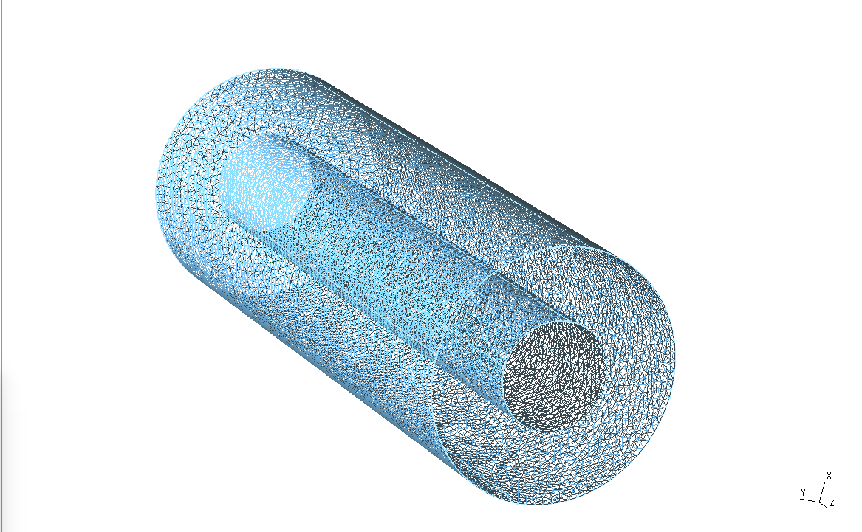
Garfield++ Operation/Purpose
Creates gas property files that reflect the gas mixtures, electric and magnetic fields.
Uses Magboltz, which solves the Boltzmann transport equations for electrons in gas mixtures under the influence of electric and magnetic fields.
16/38

Slide 17
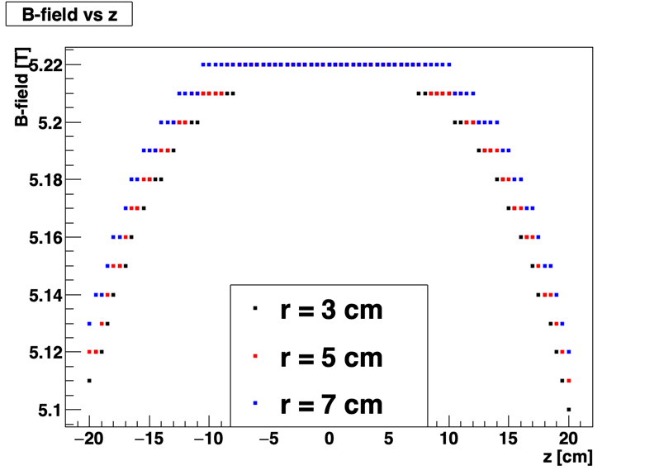
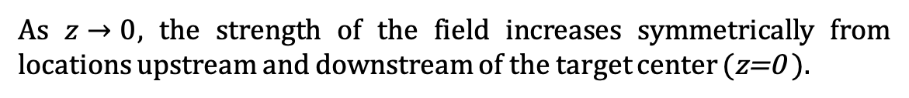
Drift-electron Analysis Solenoid Magnetic Field Map
As $z→0$, the strength of the field increases symmetrically from locations upstream and downstream of the target center (z=0 ).
17/38

Slide 18
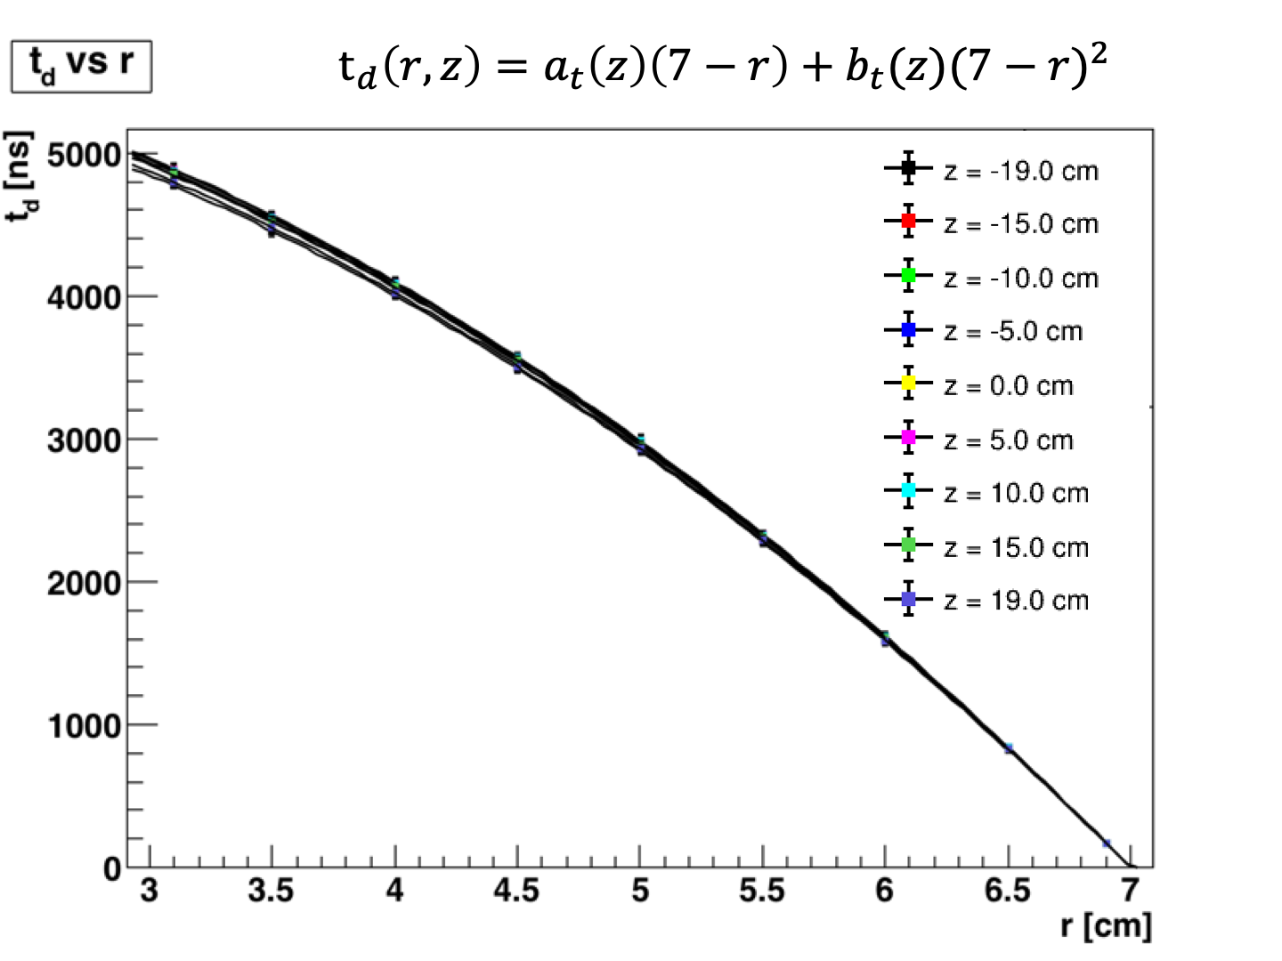
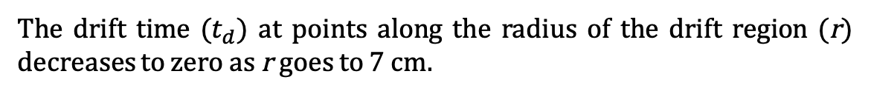
Drift-electron Analysis Garfield++
The drift time ($t_{d}$) at points along the radius of the drift region (r) decreases to zero as r goes to 7 cm.
18/38

Slide 19
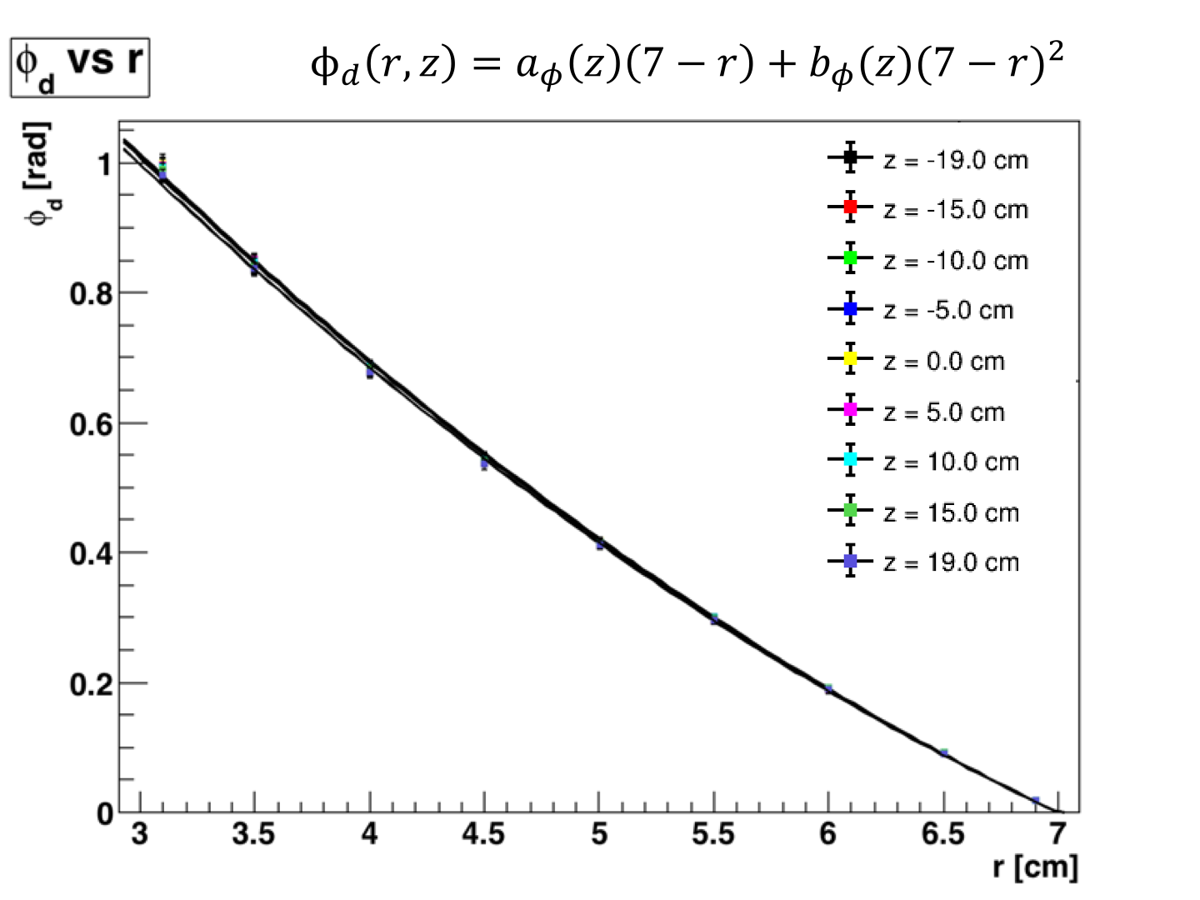
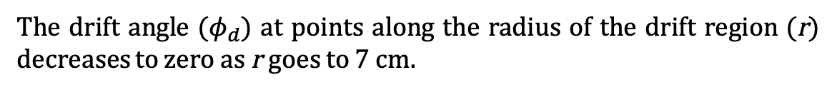
Drift-electron Analysis Garfield++
The drift angle ($φ_{d}$) at points along the radius of the drift region (r) decreases to zero as r goes to 7 cm.
$$φ_{d}\left(r,z\right)=a(z)\left(7−r\right)+b{(z)(7−r)}^{2}$$
19/38

Slide 20
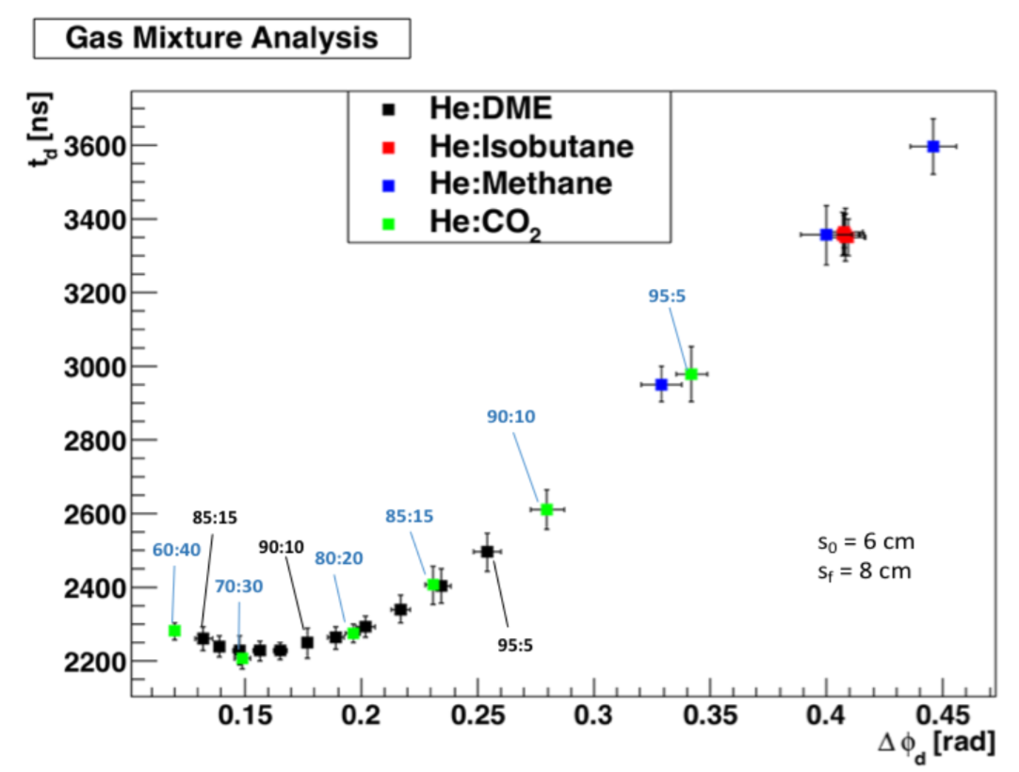
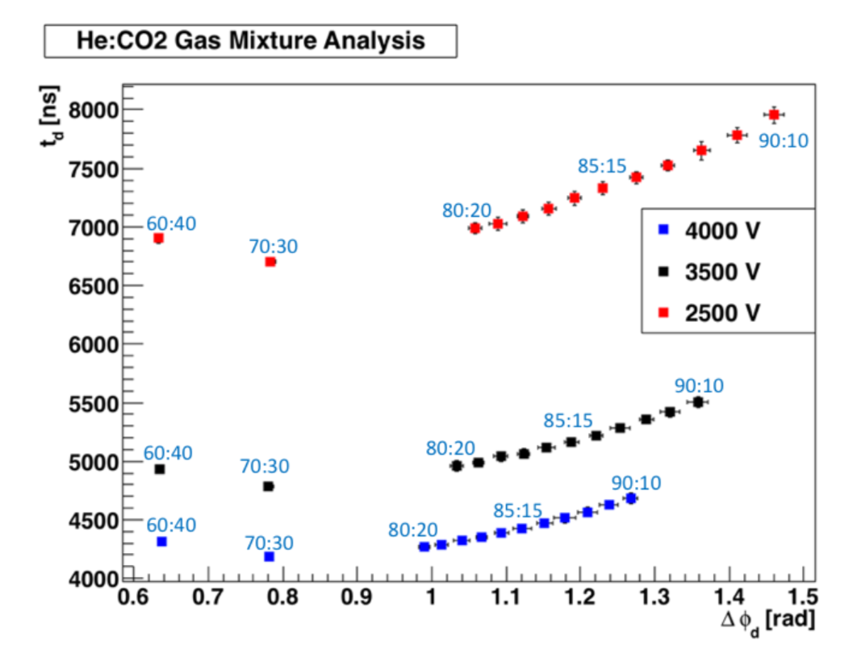
Drift-electron Analysis E-field and Gas mixture variations
Variations in electric field, gas mixture, temperature and pressure have dramatic effects on the electron drift times and drift angles.
20/38

Slide 21
Drift-gas Monitoring System Operation/Purpose
A drift chamber that measures the drift velocity of electrons for a given gas mixture, electric field, temperature and pressure.
PMTs
Field-shaping
electrodes
Anode
Scintillators
e-
e-
drift e-
drift e-
Cathode
Sr-90 sources
21/38

Slide 22
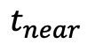
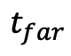
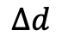
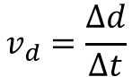
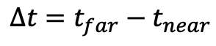
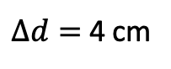
Drift-gas Monitoring System Concept
events
DISCR
TDC
DISCR
$$t_{near}$$
$$t_{far}$$
$$∆t=t_{far}−t_{near}$$
e-
e-
$∆d=$ 4 cm
Drift velocity
DISCR
$$∆d$$
$$v_{d}=\frac{∆d}{∆t}$$
22/38

Slide 23
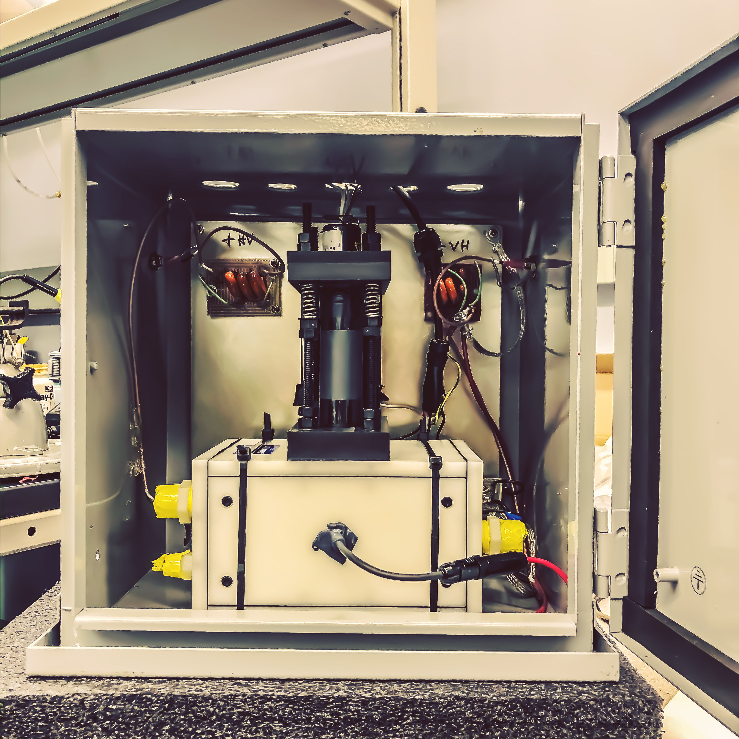
Drift-gas Monitoring System Fully Constructed
23/38

Slide 24
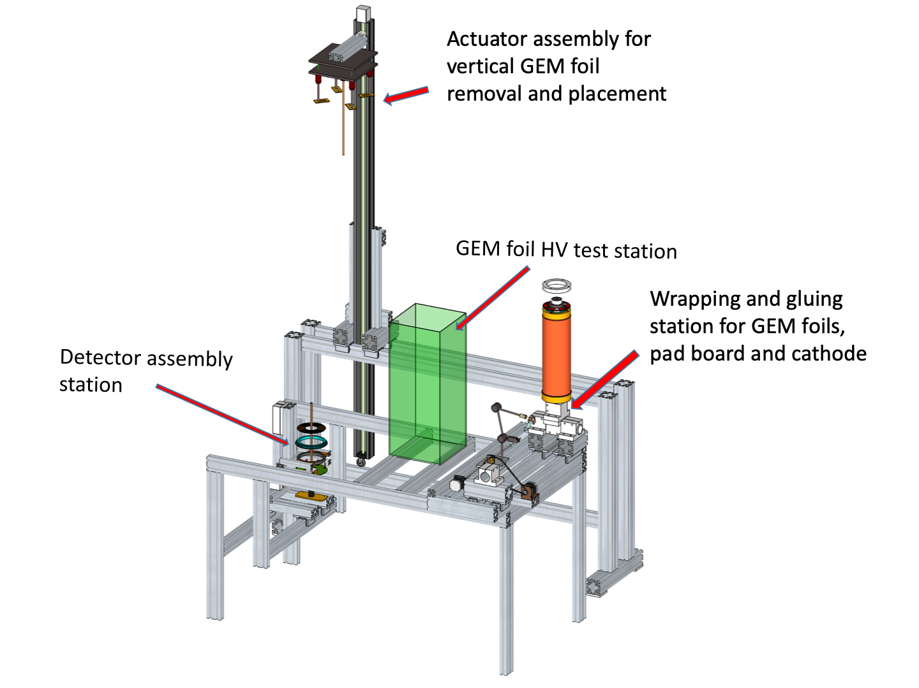
RTPC Construction Assembly Station
24/38

Slide 25
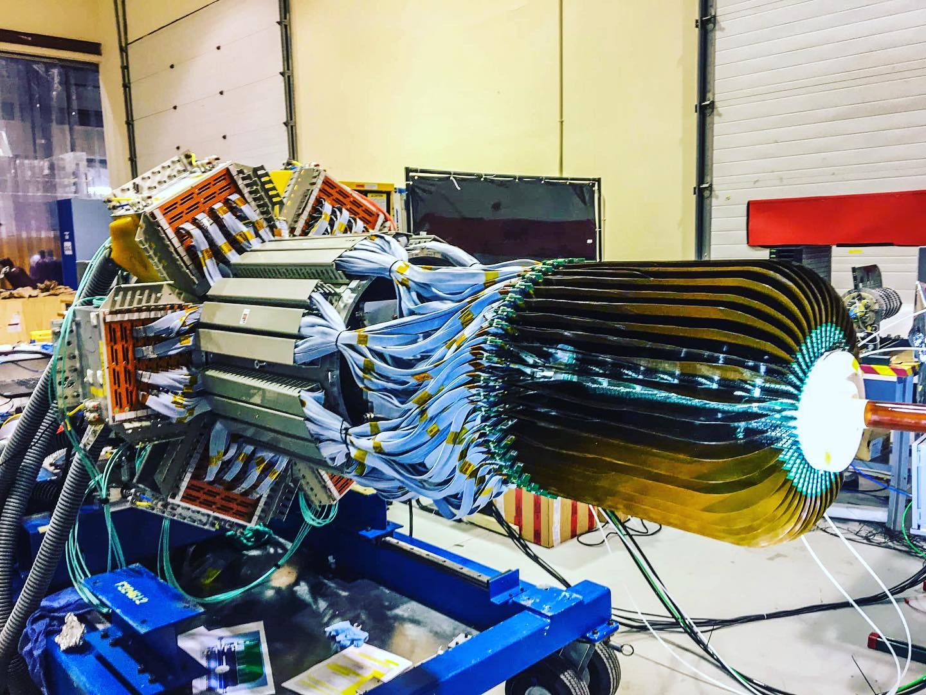
RTPC Construction Fully Assembled
25/38

Slide 26
BONuS12 experimental run Run Group F
The BONuS12 experiment ran in the Spring 2020 for 36 days and collected 3.3 billion triggers.
RTPC1 ran for 33 days at about 50% efficiency.
5 days to swap from RTPC1 to RTPC3.
RTPC3 ran for 3 days also at about 50% efficiency.
2.8 billion of the 3.3 billion triggers included the RTPC.
The run was cut short by about half of the scheduled days by the COVID19 pandemic.
26/38

Slide 27
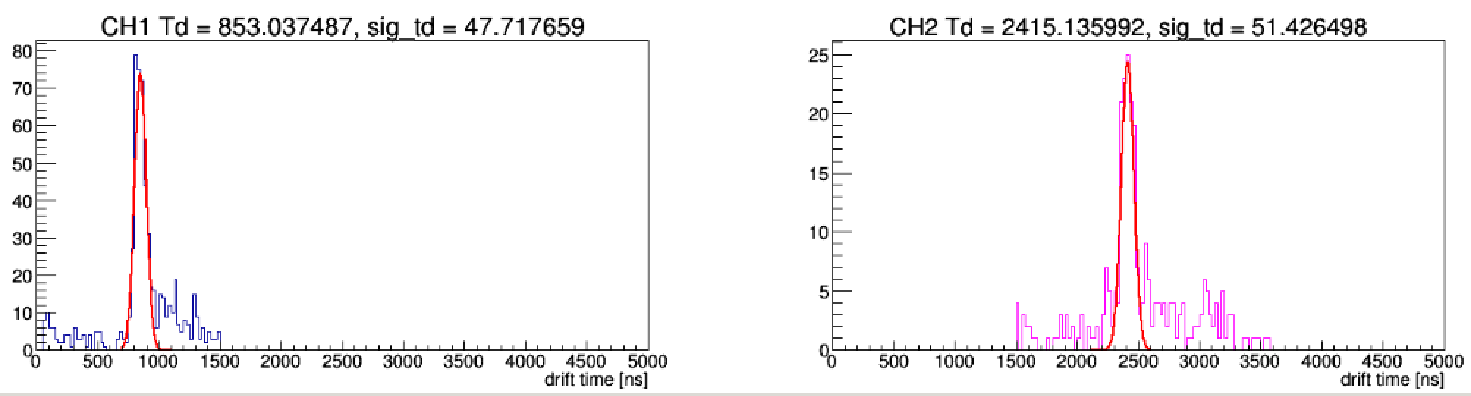
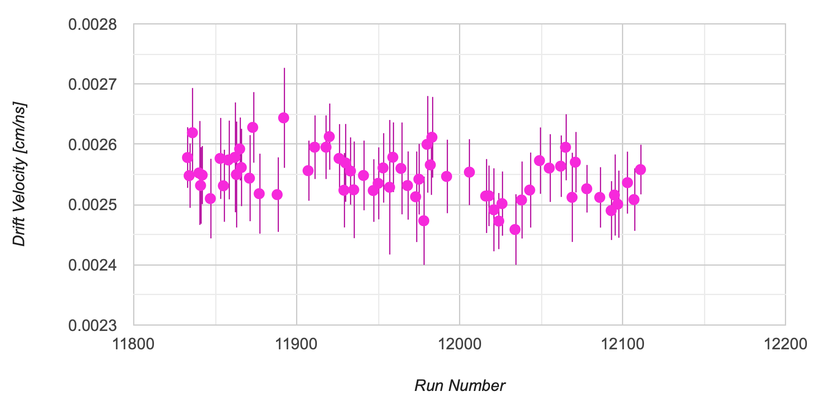
Data Analysis – Run Group F Drift-gas Monitoring System
27/38

Slide 28
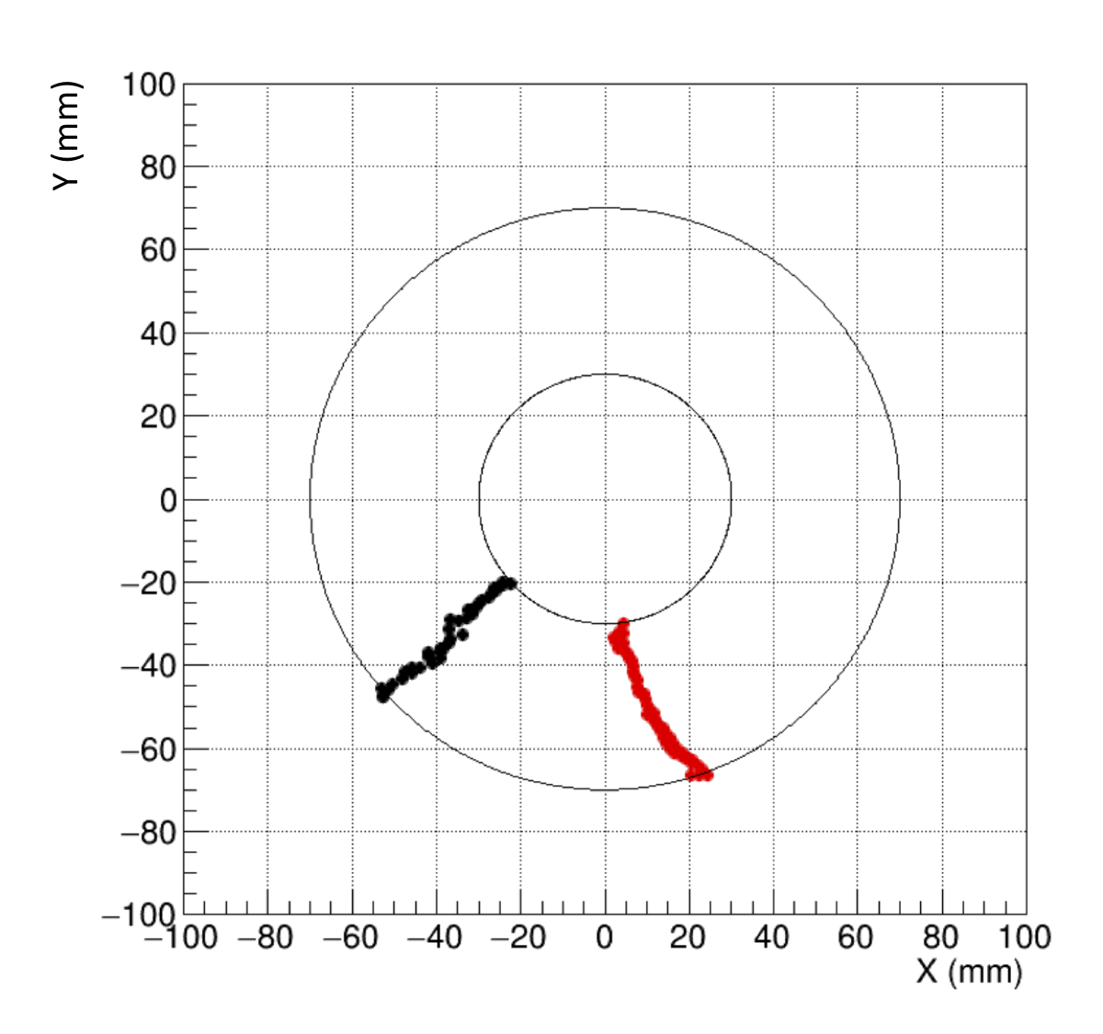
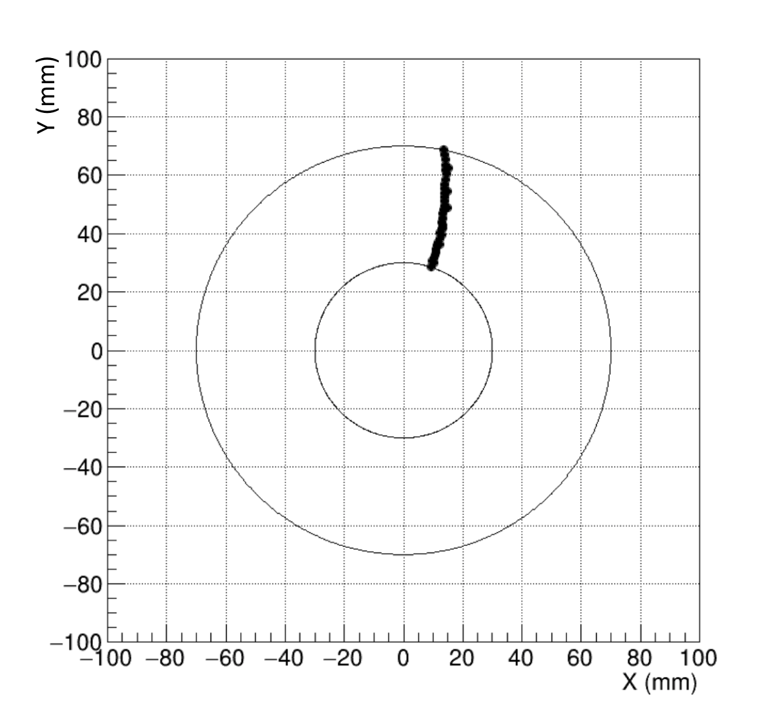
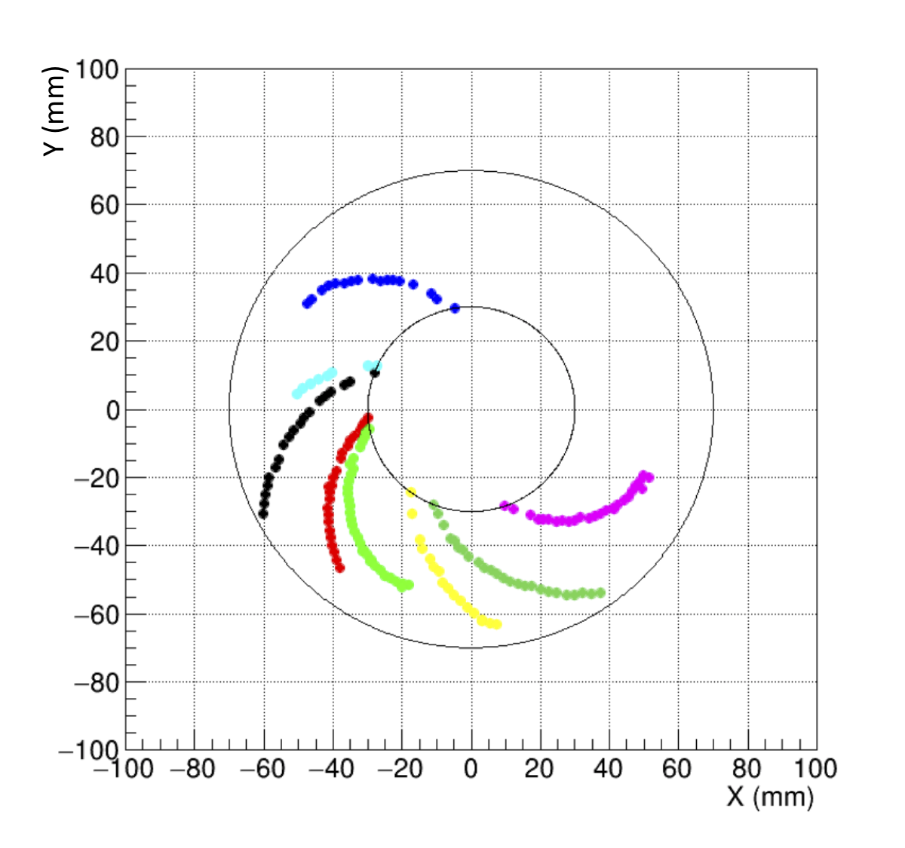
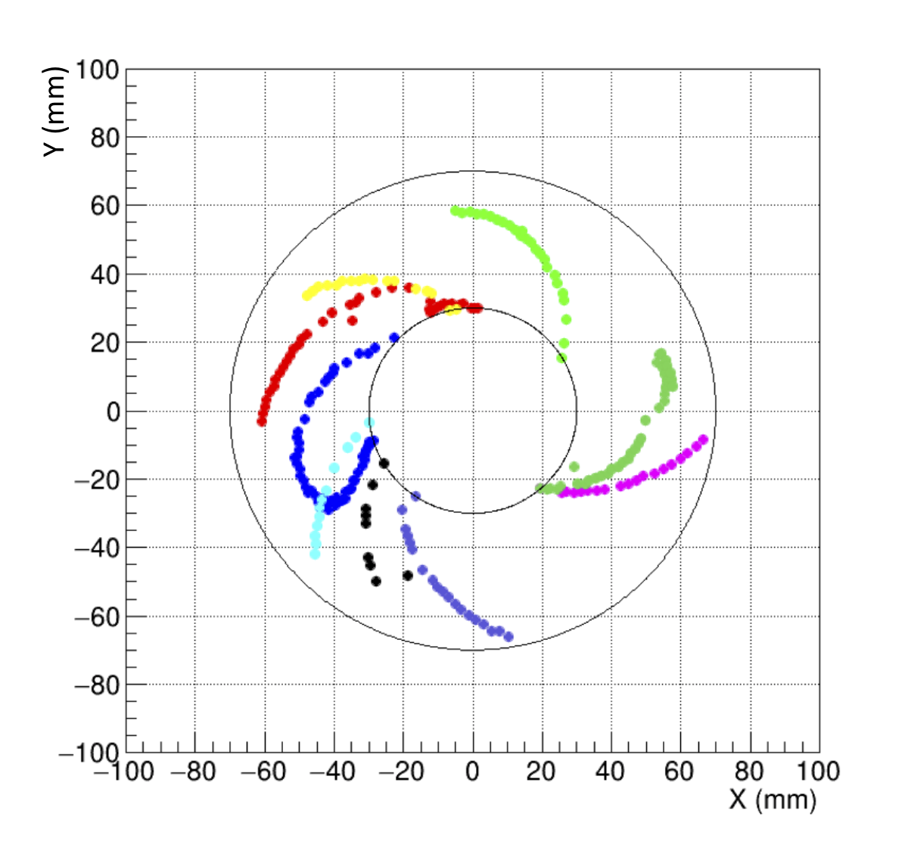
Data Analysis – Run Group F First RGF data analysis
Run 11637
2.14 GeV
5 nA
Run 12240
10.4 GeV
240 nA
Courtesy D. Payette
28/38

Slide 29
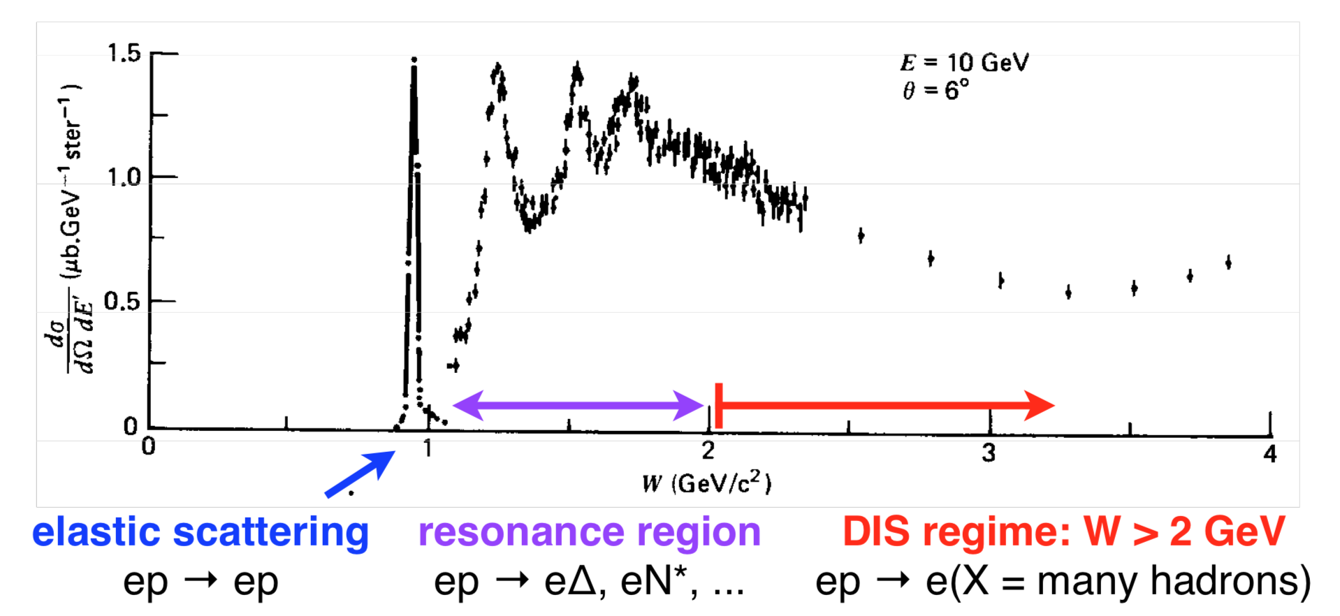
Data Analysis – Run Group A Inclusive Deep Inelastic Scattering Differential Cross Section
e’
𝛾*
p
X
e
29/38

Slide 30
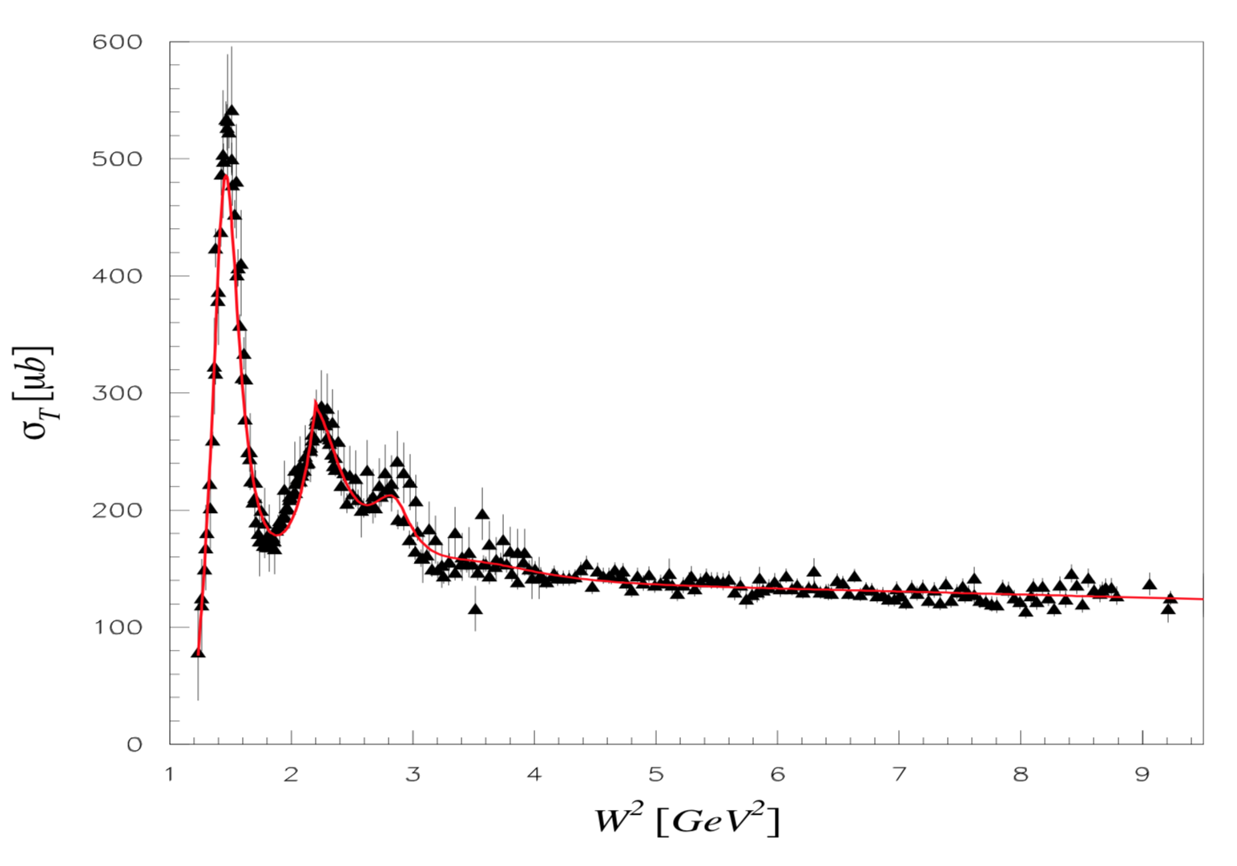
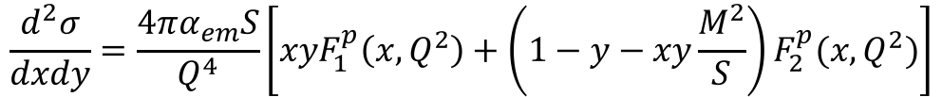
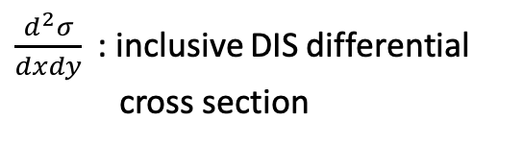
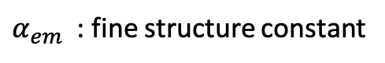
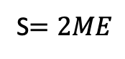
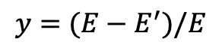

Data Analysis – Run Group A Monte-Carlo Data
$$\frac{d^{2}σ}{dxdy}=\frac{4πα_{em}S}{Q^{4}}\left[xyF_{1}^{p}\left(x,Q^{2}\right)+\left(1−y−xy\frac{M^{2}}{S}\right)F_{2}^{p}(x,Q^{2})\right]$$
$\frac{d^{2}σ}{dxdy}$ : inclusive DIS differential cross section
$α_{em}$ : fine structure constant
$M$ : proton mass
S$=2ME$
$$y=(E−E^{′})/E$$
M.E. Christy and P.B. Bosted. Phys. Rev. C, 81, p. 055213, (2010).
30/38

Slide 31

RGA Analysis Cuts Summary of cuts
DIS Kinematics
• $W>2$ GeV
• $Q^{2}>1$GeV²
Fiducial
• PCAL cuts: U > 30 cm, 30 < V < 390 cm, and 30 < W < 390 cm
• $−10<v_{z}<10$ cm • $5^{°}<θ<{40}^{°}$
Particle ID (e⁻ selection) • 5σ cut on EC ${E_{tot}}/p$ vs $p$ • HTCC cut: nphe > 5 • EC energy cuts: EPCAL > 0.06 GeV, EECin > 0.025 GeV, EECout > 0.05 GeV
31/38

Slide 32

Data Analysis – Run Group A Comparison of MC and RGA kinematics
32/38

Slide 33



Data Analysis – Run Group A Binning in $x$ and $y$
6 bins in $y$ and 20 $x$-bins in each y-bin to cover the kinematic range of the $y$ vs $x$ distribution.
33/38

Slide 34





Data Analysis – Run Group A Bin Acceptance
y=0.3375
y=0.4125
y=0.4875
y=0.5625
y=0.6375
y=0.7125
$$A\left(x,y\right)= \frac{N_{rec}}{N_{gen}}$$
$$δA\left(x,y\right)= \frac{A(x,y)}{\sqrt{N_{rec}}}$$
34/38

Slide 35








Data Analysis – Run Group A RGA Inclusive DIS Differential Cross Section Calculation
$$\frac{d^{2}σ}{dxdy}= \frac{N(x,y)}{ℒ_{int}A(x,y)ΔxΔy}$$
$$δ\left(\frac{d^{2}σ}{dxdy}\right)= \frac{{d^{2}σ}/{dxdy}}{\sqrt{N(x,y)}}$$
$\frac{d^{2}σ}{dxdy}$ : inclusive DIS differential cross section
$N(x,y)$ : number of reconstructed DIS events in the $x,y$ bin
$ℒ_{int}$ : time integrated luminosity
$A(x,y)$ : acceptance of the $x,y$ bin
$Δx$ : $x$bin size
$Δy$ : $y$bin size
$δ\left(\frac{d^{2}σ}{dxdy}\right)$ : uncertainty on the cross section
35/38

Slide 36








Data Analysis – Run Group A Inclusive DIS differential cross section
$\frac{d^{2}σ}{dxdy}$ [nb]
$$x_{B}$$
36/38

Slide 37
Conclusions
The extracted inclusive DIS differential cross sections from Run Group A data were consistent with fits to existing data.
The simulation and development of the BONuS12 RTPC was successful.
The DMS worked successfully and helped to determine variations in the drift-gas parameters that it was meant to monitor during the BONuS12 experiment.
The BONuS12 RTPC worked relatively well during its 36 day run. There was a substantial amount of data collected that will be calibrated and analyzed for years to come.
37/38

Slide 38
References
Beringer et al., Phys. Rev. D86, 010001 (2012).
Ciofi degli Atti and Kopeliovich, Eur. Phys. J. A17 (2003) 133.
E.D.Bloon et.al, Phys. Rev. Lett 23 (1969) 930
H1 Collab., I. Abt et al.,Nucl. Phys. B407 (1993) 515.
M. Sargsian and M. Strikman, Phys. Lett. B639 (2006) 223.
S. Tkachenko et al. Phys. Rev. C89 (2014) 045206.
W. Melnitchouk, M. Sargsian and M.I. Strikman, Z. Phys. A359 (1997) 99.
ZEUS Collab., M. Derrick et al., Phys. Lett. B316 (1993) 412.
M.E. Christy and P.B. Bosted, Phys. Rev. C, 81, (2010) 055213.
38/38

Slide 40
Backups

Slide 41

RGA Analysis Summary of Systematic Errors
Source | Systematic Uncertainty (%) | Explanation
$$e^{+}$$ | 1.0 | Effect of pair-symmetric contamination
$$π^{−}$$ | 1.0 | Effect of pion contamination
MC | 3.0 | Combined uncertainty due to Monte-Carlo statistics and systematics
TOTAL | 3.32 | Added in quadrature
A

Slide 42



RGA Analysis Cuts EC
Uncut
Cut
U > 30 cm
30 < V < 390 cm
30 < W < 390 cm
PCAL
EPCAL > 0.06 GeV
EECin > 0.025 GeV
EECout > 0.05 GeV
EC_{in}
EC_{out}
B

Slide 43




RGA Analysis Cuts Sampling fraction
$${\left(\frac{E_{tot}}{p}\right)}_{+2.5σ}=0.008p^{2}−0.0112p+0.3137$$
$${\left(\frac{E_{tot}}{p}\right)}_{−2.5σ}=−0.0017p^{2}+0.0228p+0.1397$$
C

Slide 44


BONuS12 Analysis Off-shell corrections
Neutron off-shell mass squared
$$p^{2}≈M^{2}+2Mε_{d}−2p_{s}^{2}$$
The bound neutron structure functions depend on this off-shell mass squared and can introduce deviations of the extracted structure functions to their on-shell values.
Restricting the detection of only low momentum protons reduces this dependence to a few percent around $p≈100$ MeV/c and less than a percent $p≈70$ MeV/c.
D

Slide 45

BONuS12 Analysis EMC effect and nuclear corrections
Bound nucleons do not behave the same as free protons and neutrons. Between 0.3 < x < 0.8 the EMC effect must be a correction to the ratio. For x > 0.8, Fermi motion, which describes the movement of the nucleons within the nucleus dominates.
E

Slide 46










Drift-gas Monitoring System Expected rate assuming point source
$$\tan{γ}=\frac{d}{2b}$$
$$γ$$
Solid angle element
$$Ω_{f}=πγ^{2}=π{\left(\tan^{−1}{\frac{d}{2b}}\right)}^{2}$$
$$d$$
Fraction of solid angle
$$f=\frac{Ω_{f}}{Ω_{tot}}=\frac{Ω_{f}}{4π}=\frac{1}{4}{\left(\tan^{−1}{\frac{d}{2b}}\right)}^{2}$$
$$b$$
$$d=0.65 cm \\ b=13 cm$$
$$f=0.000156$$
$A=2 uCi=74000$decays per sec
$$a=fA≈12 Hz$$
F

